Slide 1
TEAM-11 mentor:Shreeyesh
WEB DEVELOPMENT
---Sreevani (1st Year it)
----Sravan kumar (1st Year cse)
----Lakshmi anuhya (3rd year CSE)
Database and restapi
---kaveri (1st Year cse)
---pushpak (2nd year cse)
android development
---Ehab (2nd year it)
----shariq ahmed (2nd year it)
---swathi (2nd year cse)

Slide 2
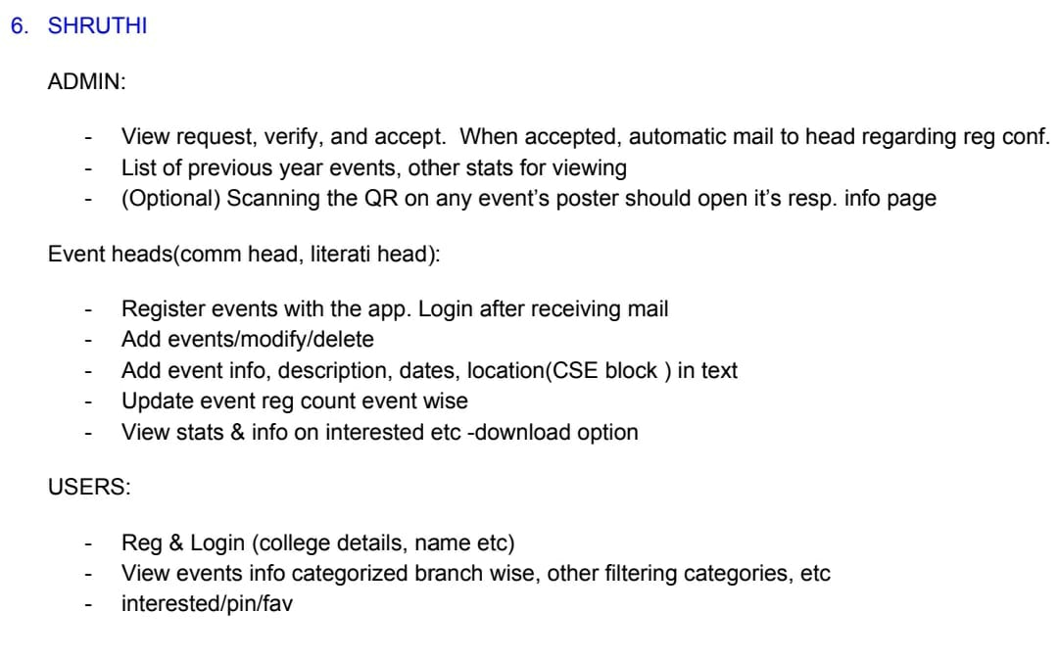
problem STATEMENT

Slide 3
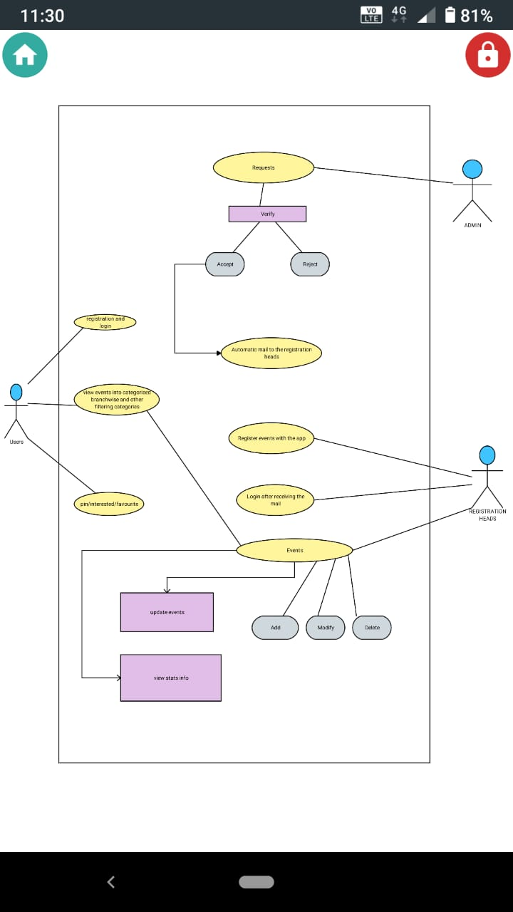
UML DiAGRAM

Slide 4
Web development

Slide 5

homepage
This is the homepage. Here we are having links to the user registration and the user login and admin login provided at the top.

Slide 6
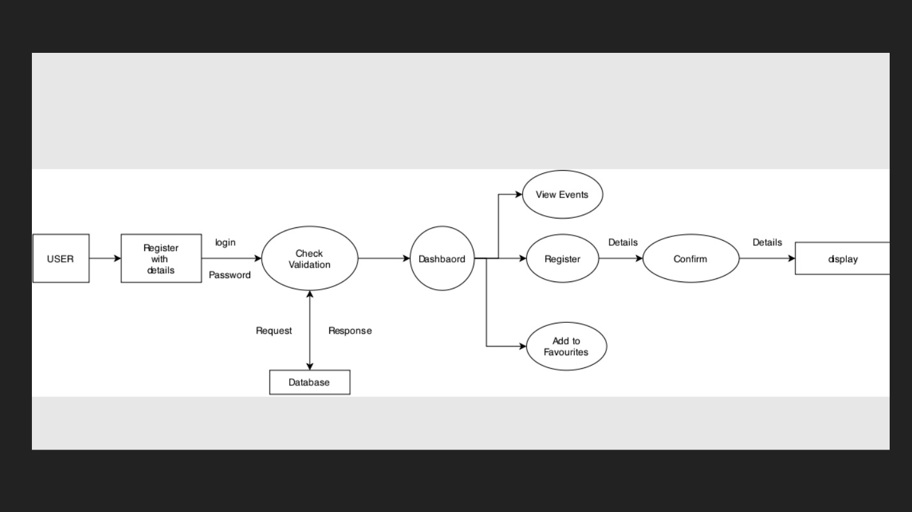
design flow of user

Slide 7
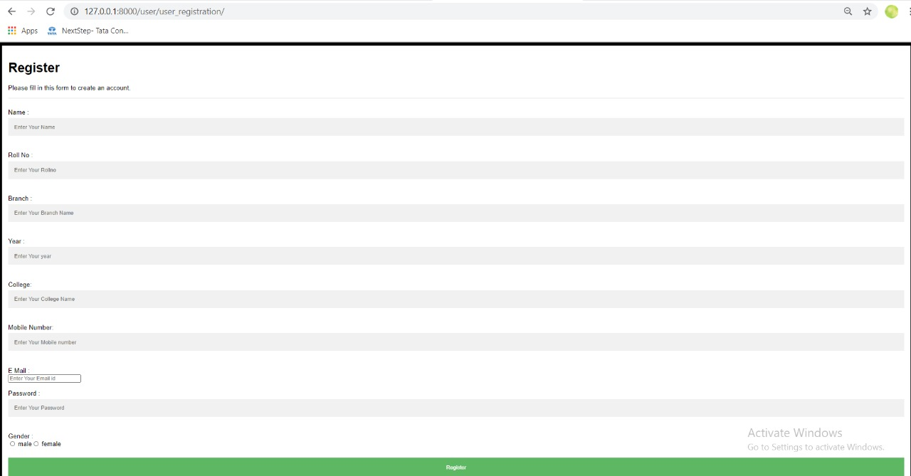
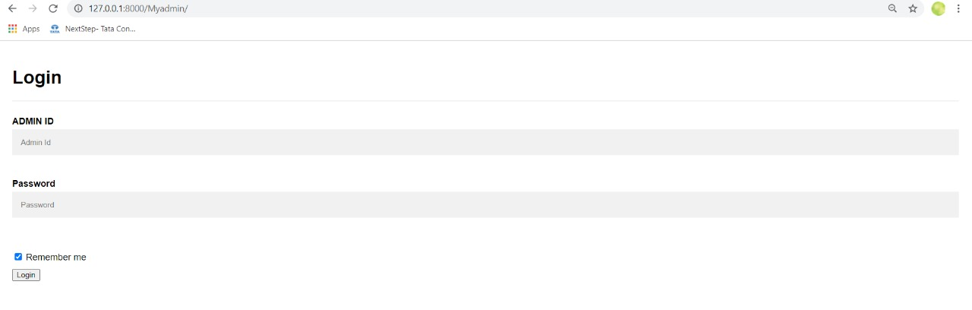
User registration and login
After the user registered successfully….they can login to the website through login page by filling necessary credentials.

Slide 8
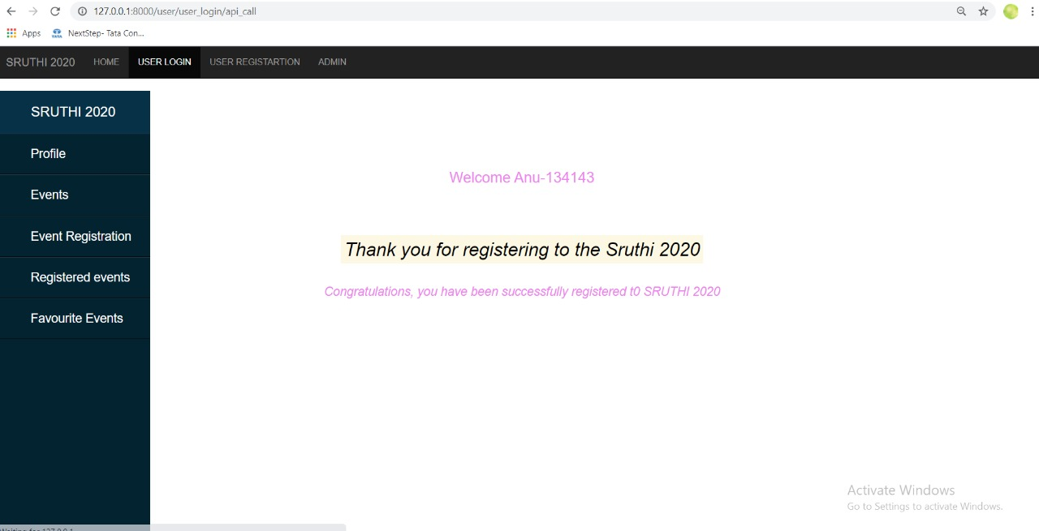
User portal
This is the user portal where the user can register for the events and other info regarding the events is given
Here you can see what all the events the user had registered for and favourite events.
Now, the admin can directly login.

Slide 9
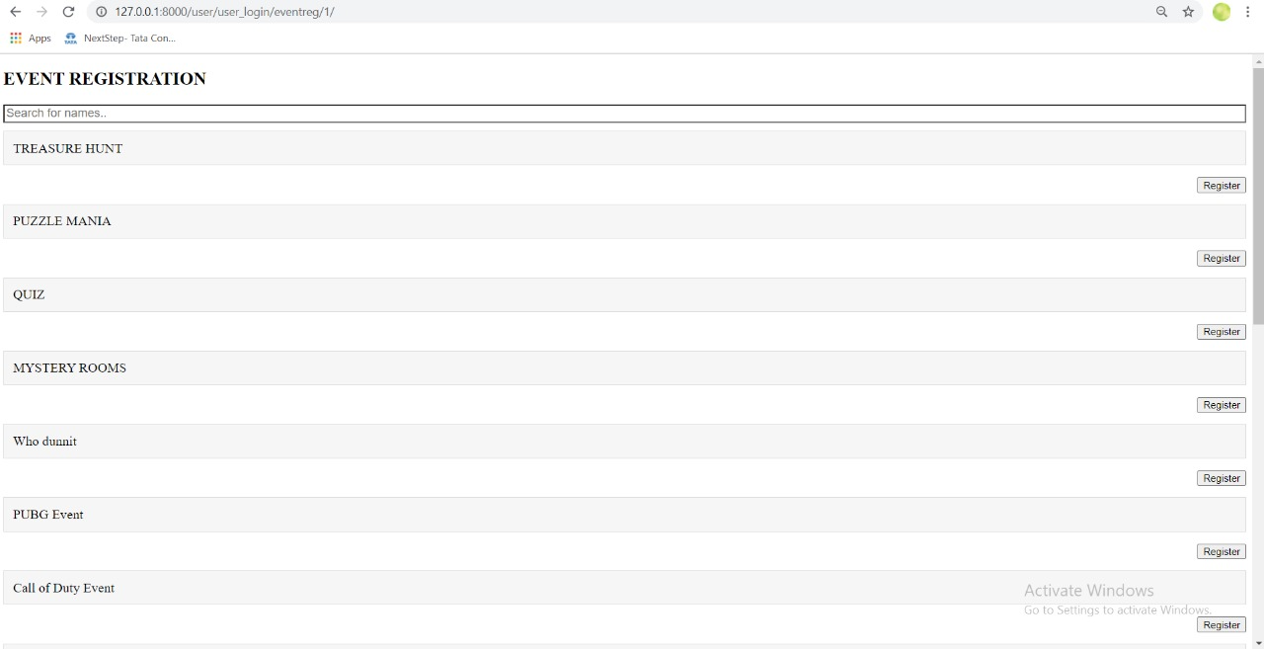
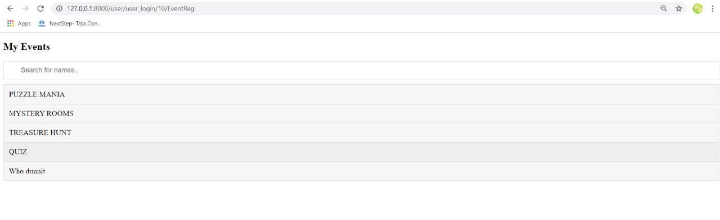
The events that the user want to be added can be registered through event registration page and can view registered events
Event registration
Registered events

Slide 10
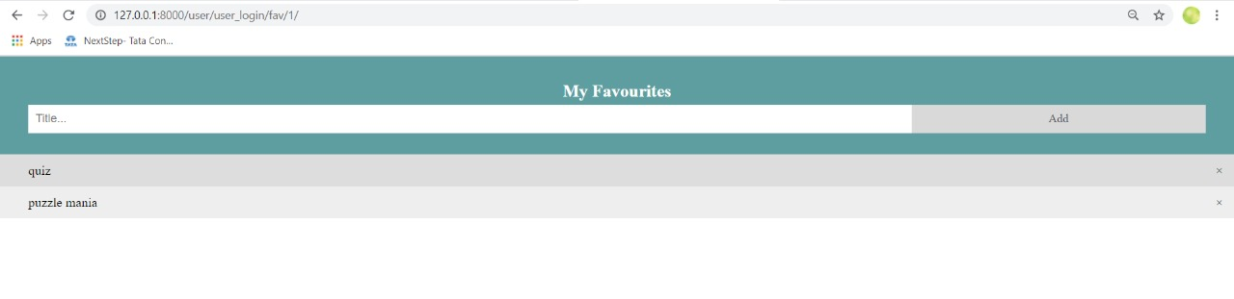
Favourite events
The favourites events that the user selected will be visible in this page

Slide 11
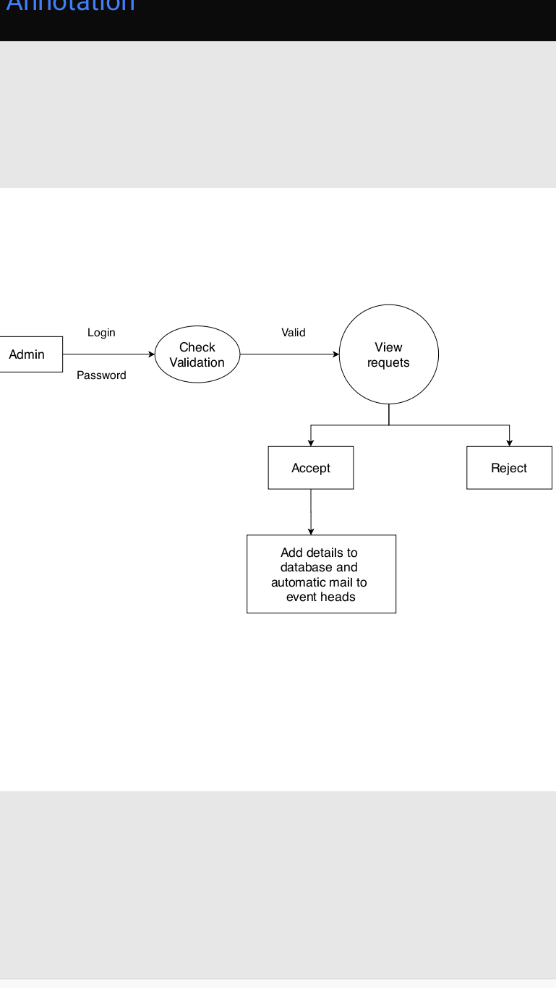
Design flow of admin

Slide 12
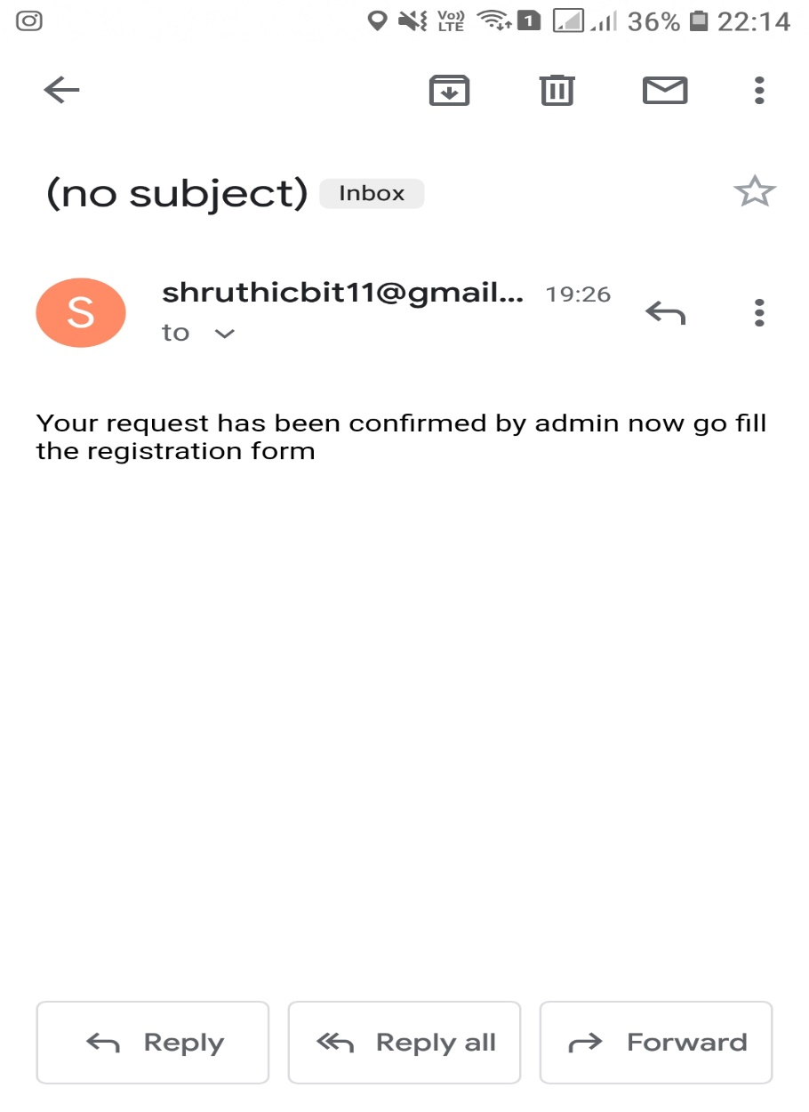
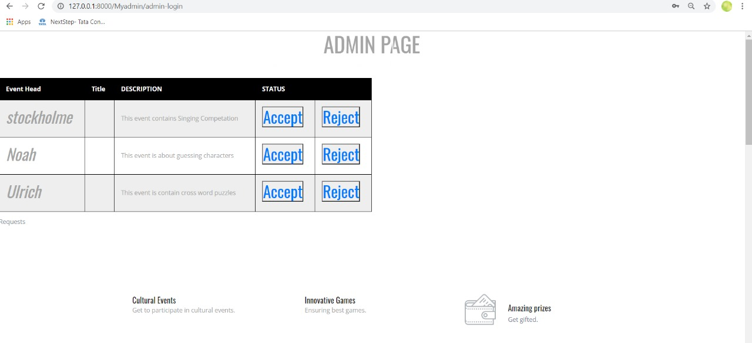
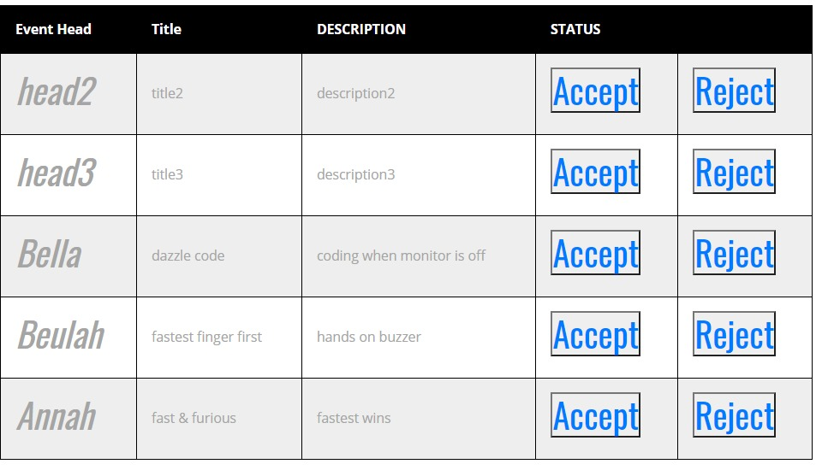
Admin page
In admin page we have requests displayed which are registered in android.
Here the admin can accept requests or reject. Once accepted an automatic mail is sent to the event head.

Slide 13

DATABASE AND APIS

Slide 14
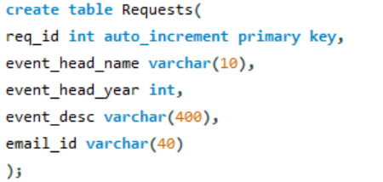
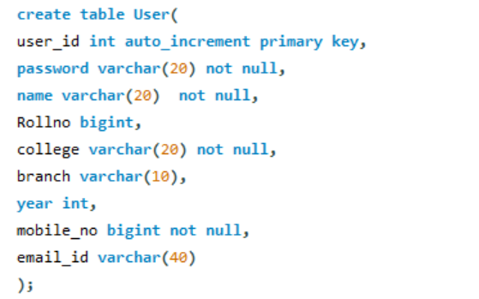
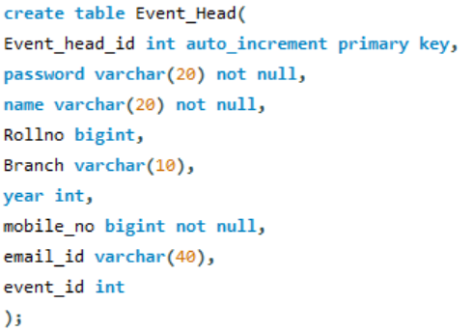
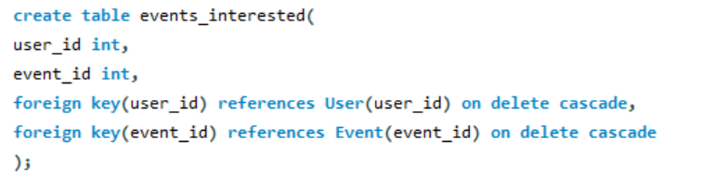
DATABASE

Slide 15
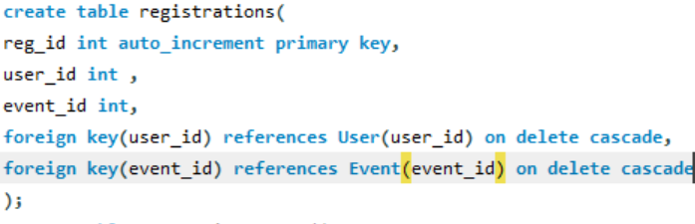
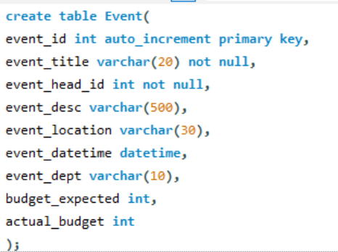
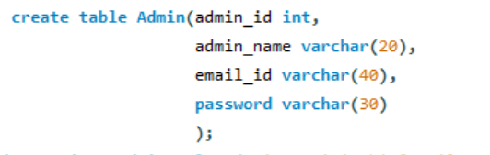
DATABASE

Slide 16
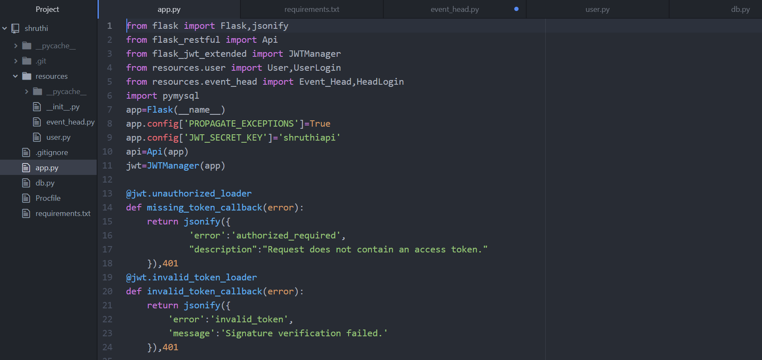
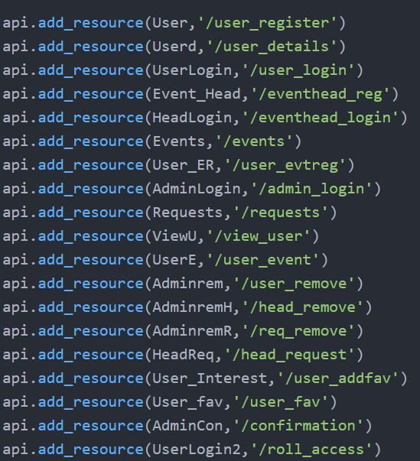

Slide 17
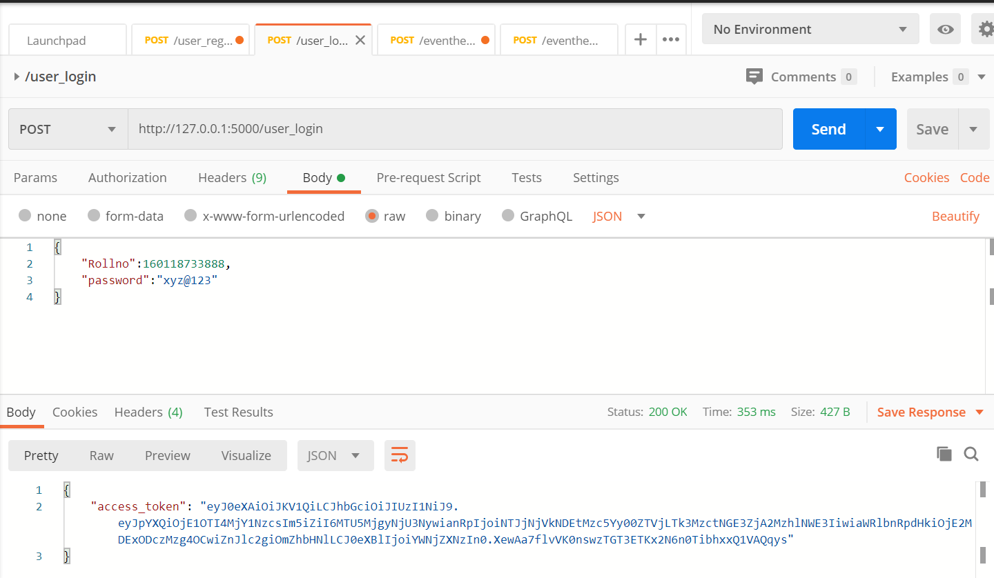
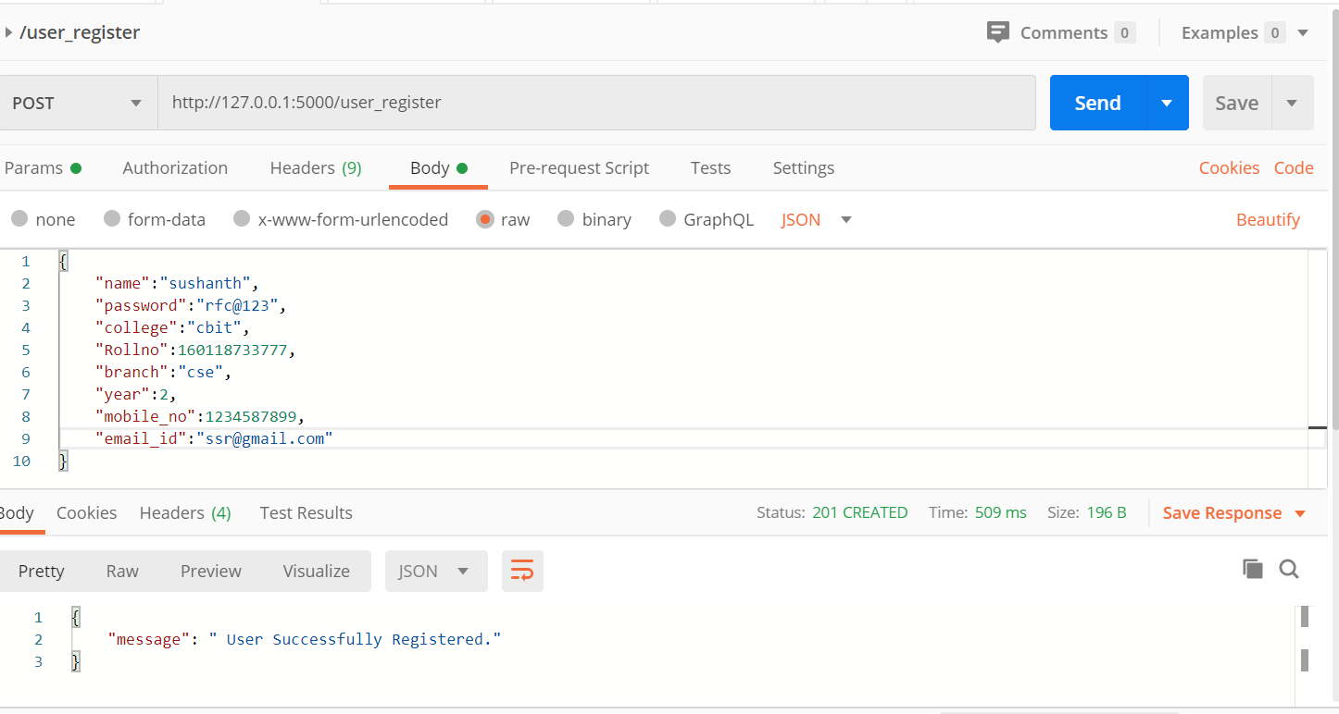

Slide 18
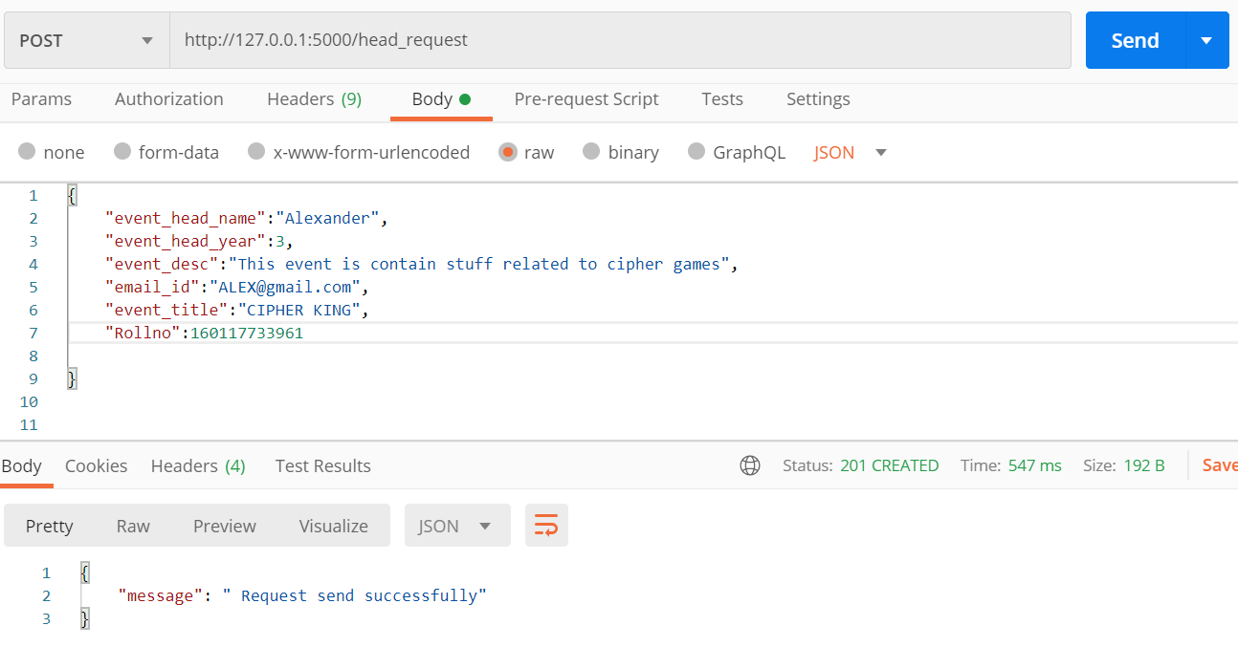
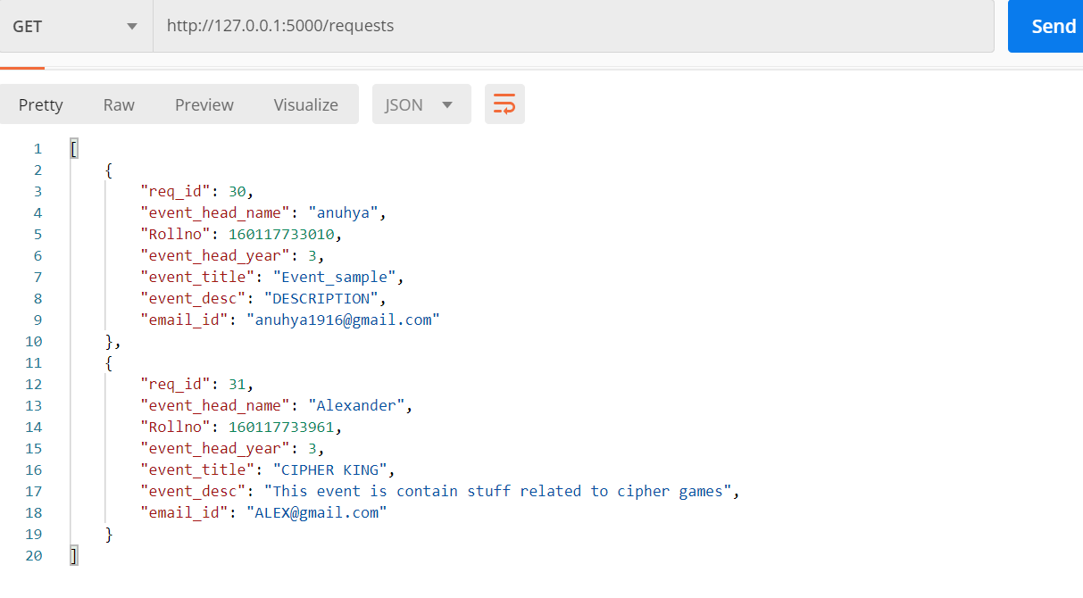

Slide 19
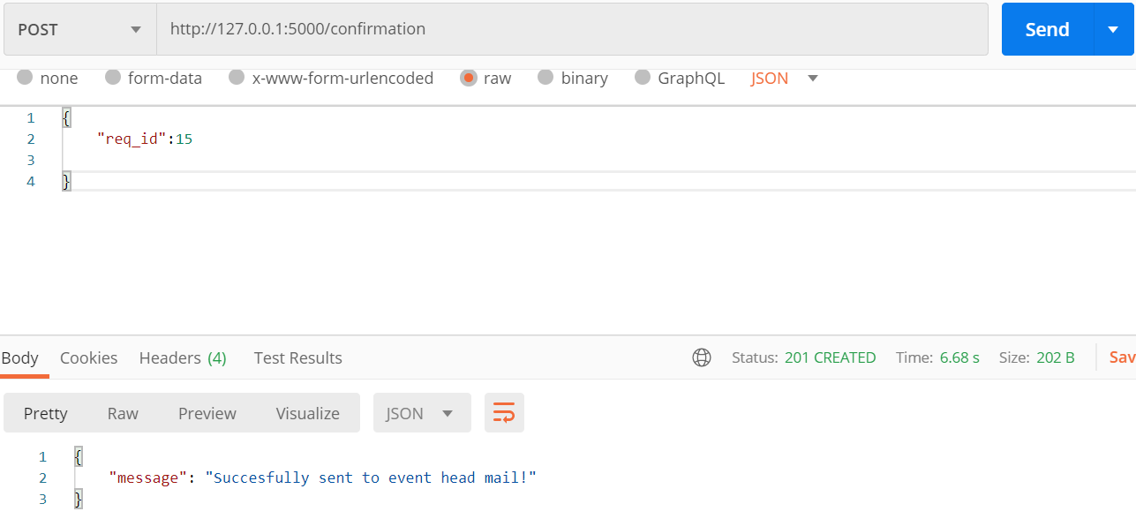
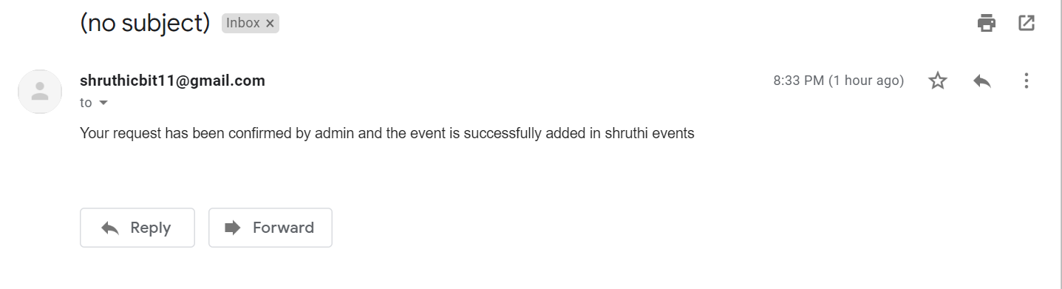

Slide 20

NETBEANS

Slide 21
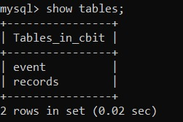
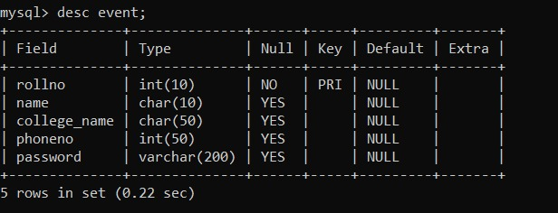
MY SQL TABLES

Slide 22
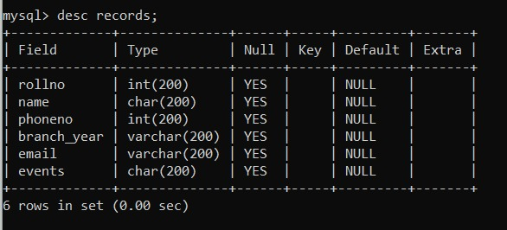
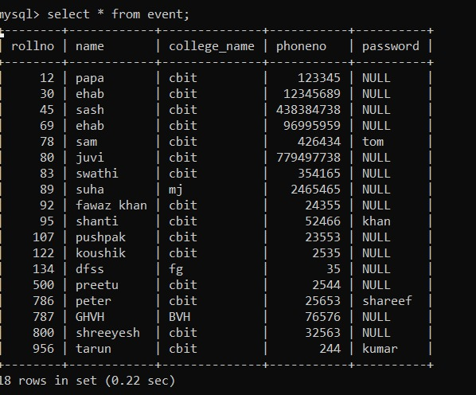

Slide 23
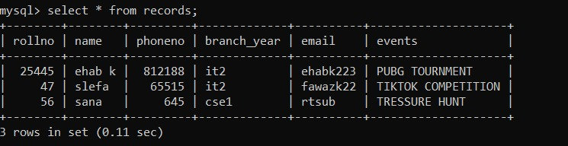

Slide 24
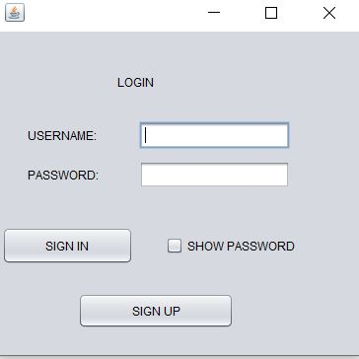
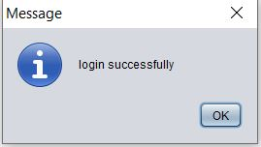
LOGIN PAGE
Login page will be directed to registration page if we didn’t sign up before.If we sign up with correct username and password its login successfull.

Slide 25
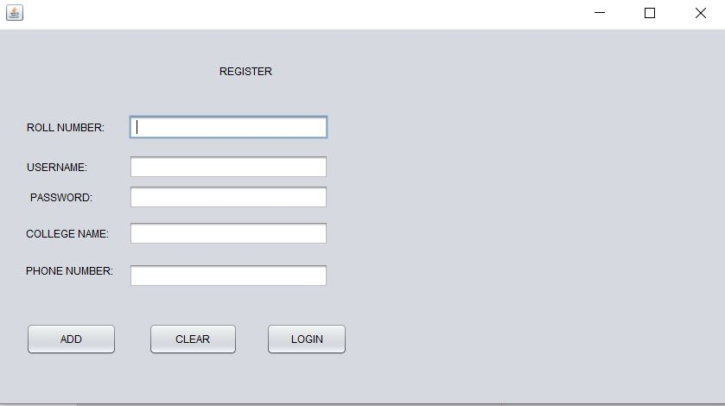
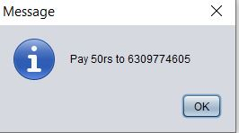
REGISTRATION PAGE
This is the registration page used to register for the shruthi event.Where we can add clear as well as login.And displays the message box to pay the fee

Slide 26
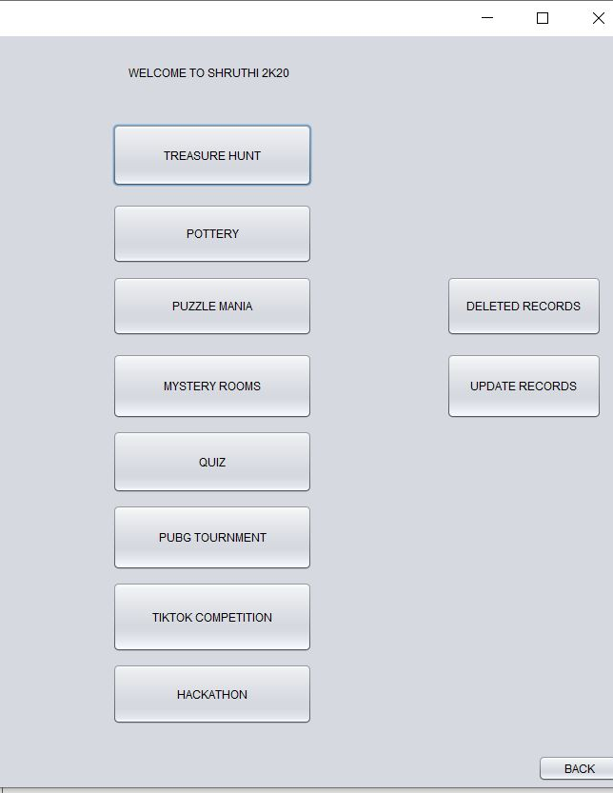
EVENTS PAGE
Here is the event page where we can register for events of shruthi .when we click on each event we will be directed to the respective event page.

Slide 27
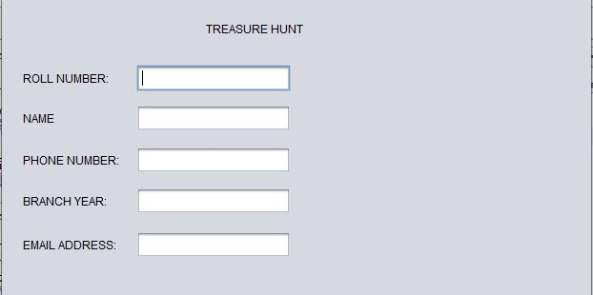
TREASURE HUNT

Slide 28
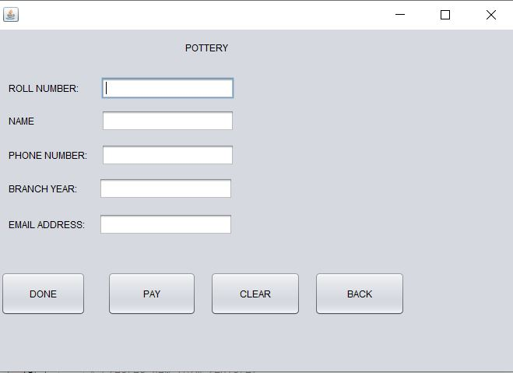
POTTERY

Slide 29
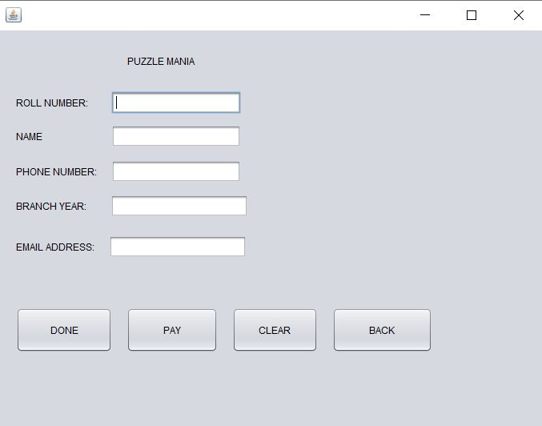
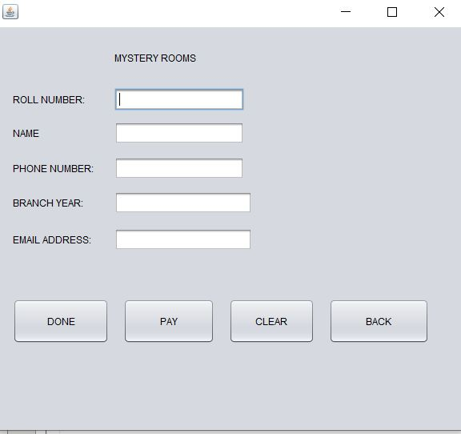
PUZZLE MANIA
MYSTERY ROOMS

Slide 30
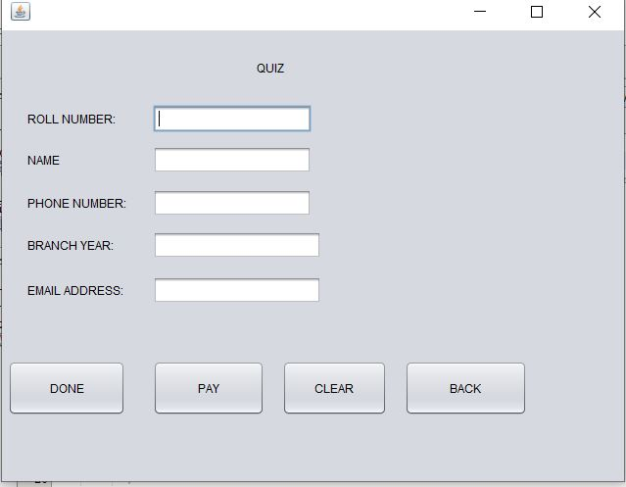
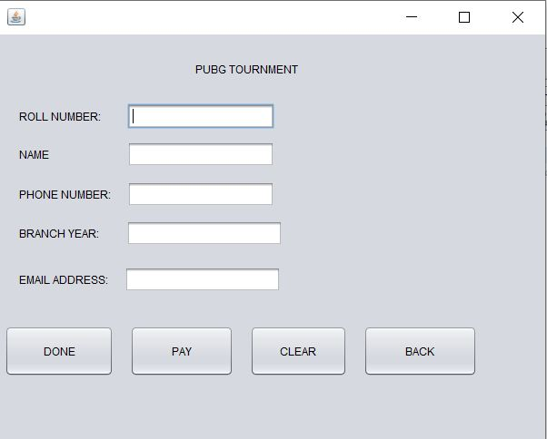
QUIZ
PUBG TOURNMENT

Slide 31
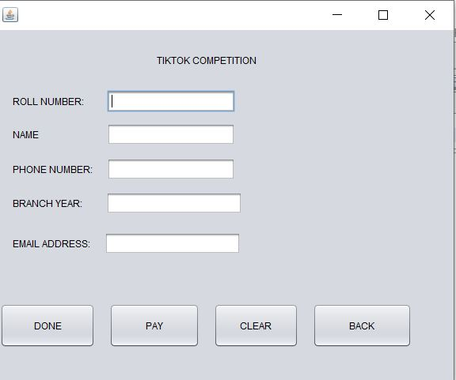
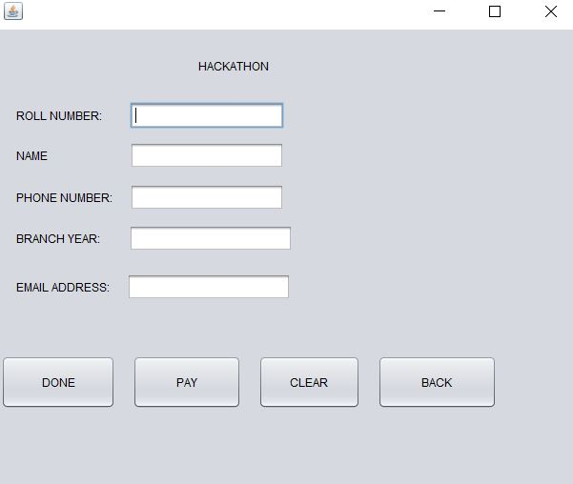
TIKTOK COMPETITION
HACKATHON

Slide 32
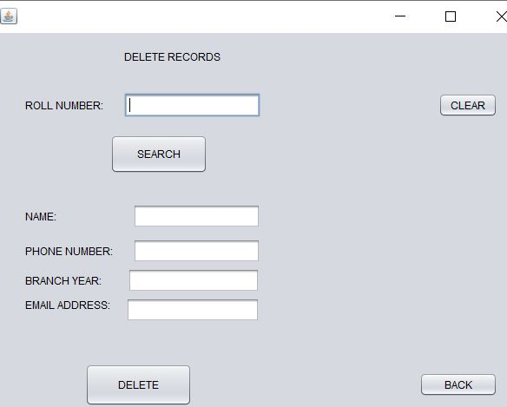
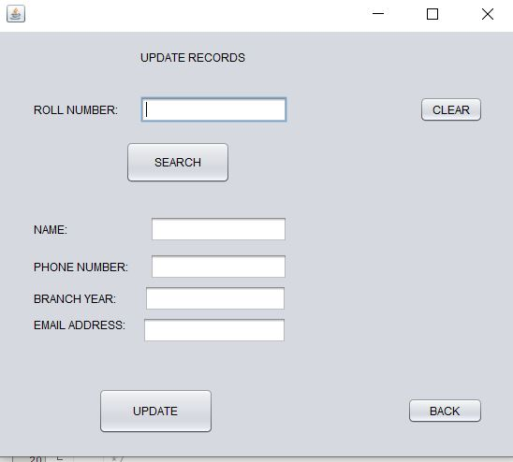
DELETED RECORDS
UPDATE RECORDS

